Slide 1
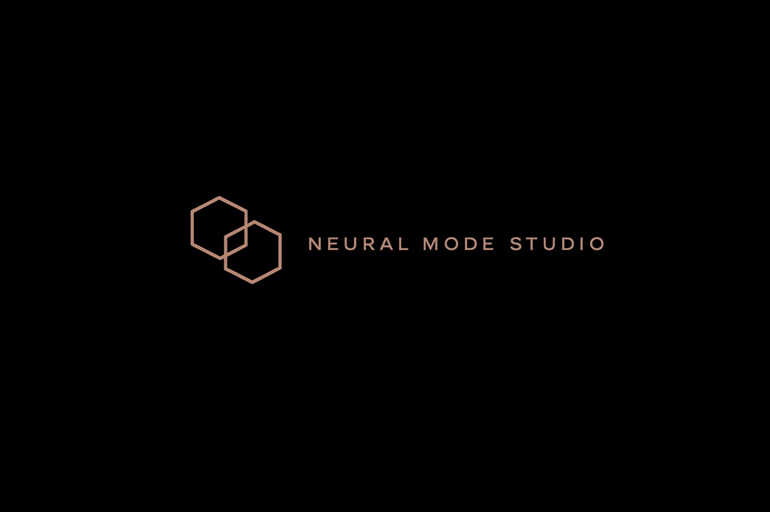
AI Road Trip
Europe Tour
Build the business, website, and AI system in one day.
A Full-Day AI Business Building Intensive · Patrick Ribbsaeter
EUR 2,497 – 4,997 · 24 Seats Per City · Limited European Dates

Slide 2
THE PROBLEM
Most people use AI randomly.
Operators build systems.
01
02
03
Tools are everywhere.
The gap is operational.
One focused room.
Structured execution is rare. Having access to tools doesn't translate to business outcomes.
Knowing what to build, how to prompt, how to debug, and how to launch — that's the real edge.
This day compresses months of scattered AI learning into a single, structured execution sprint.
AI Road Trip: Europe Tour · Patrick Ribbsaeter / Neural Mode Studio

Slide 3
WHO IT IS FOR
Built for ambitious beginners
and serious operators.
1
2
3
4
5
Founders &
Startup Teams
Creators &
Consultants
Freelancers &
Business Owners
Marketers &
Builders
Anyone Who Wants
Real Leverage
Build AI-powered operations from day one.
Turn expertise into scalable AI-built offers.
Automate the grind. Ship better work faster.
Prompt, build, launch — in real time.
Practical systems, not passive theory.
If you want practical AI leverage — not passive theory — this room is for you.
AI Road Trip: Europe Tour · Patrick Ribbsaeter / Neural Mode Studio

Slide 4
THE FRAMEWORK
From idea to
business system.
01
02
03
04
05
06
Offer
Website
AI Workflow
Automation
Content
Launch
Position the offer
Build the digital front end
Design the AI operating layer
Connect workflows and tools
Create launch assets
Leave with a roadmap
AI Road Trip: Europe Tour · Patrick Ribbsaeter / Neural Mode Studio

Slide 5
VIBE CODING
neural-mode.build — bash
Fast building.
// AI Build Session — initiated
Without losing
judgment.
const offer = await buildOffer({
target: 'premium_consulting',
positioning: promptSystem.run(),
reviewLoop: true, // always
});
Use AI coding tools without blindly accepting output.
const site = deploy({
stack: ['next', 'vercel', 'supabase'],
content: offer.copy,
Understand prompts, files, APIs, backend logic, SQL, and debugging.
humanReview: true, // non-negotiable
});
await automations.connect(site);
Build with taste, structure, and review loops.
await launchSystem.go();
// ship. review. iterate.
Speed matters — but control matters more.
AI Road Trip: Europe Tour · Patrick Ribbsaeter / Neural Mode Studio

Slide 6
INSIDE THE STACK
Patrick's real AI
operating workflows.
RESEARCH & STRATEGY
CONTENT & WRITING
LLM Research Workflows
Prompt Systems for Business
Deep research, competitive analysis, strategy documents — built with structured prompt chains, not one-shot queries.
Voice-consistent content and copy at scale. System prompts, persona files, and structured output templates.
BUILD & CODE
AUTOMATION & OPS
Vibe Coding With Control
Agents & Automations
AI-assisted development with judgment. Build sites, tools, and scripts without losing oversight of the output.
Recurring tasks automated. Real workflows from Patrick's own businesses — live stacks, not hypothetical demos.
AI Road Trip: Europe Tour · Patrick Ribbsaeter / Neural Mode Studio

Slide 7
OUTCOMES
Not just notes.
A sharper execution system.
01
Clearer Business Offer
02
Better AI Tool Stack
03
Practical Prompt Workflows
A positioned, communicable offer ready to take to market.
A curated, purposeful stack — not tool soup.
Reusable prompt systems for your actual work.
04
Build Roadmap
05
Launch & Content Plan
06
Confidence to Ship
Website and product build direction with clear next steps.
A real direction for getting the business in front of people.
The hardest thing. Leave knowing how to keep moving.
AI Road Trip: Europe Tour · Patrick Ribbsaeter / Neural Mode Studio

Slide 8
SEAT ACCESS
Limited city rooms.
High-intensity practical format.
EARLY BIRD
STANDARD
VIP IMPLEMENTATION
EUR 2,497
EUR 3,997
EUR 4,997
First 8 seats per city
General admission
Full-day + implementation support
24 seats per city · Intimate format · In-person only
APPLY FOR EARLY-BIRD ACCESS →

